Slide 1

Team New Hampshire
District Deputy Orientation 2026-2027
Raymond Sands
Regional Growth Specialist-Central
Raymond.sands@kofc.org
Notes:
PRAISED BE JESUS CHRIST
We thank God for giving us this time together to do his will
Congratulation on making both your CoH membership goal and your Q4 goal
Thank you for your dedication and sacrifice
But we cannot rest on what was we need to focus on how we continue to give the Knights of Colombus a future in NH

Slide 2

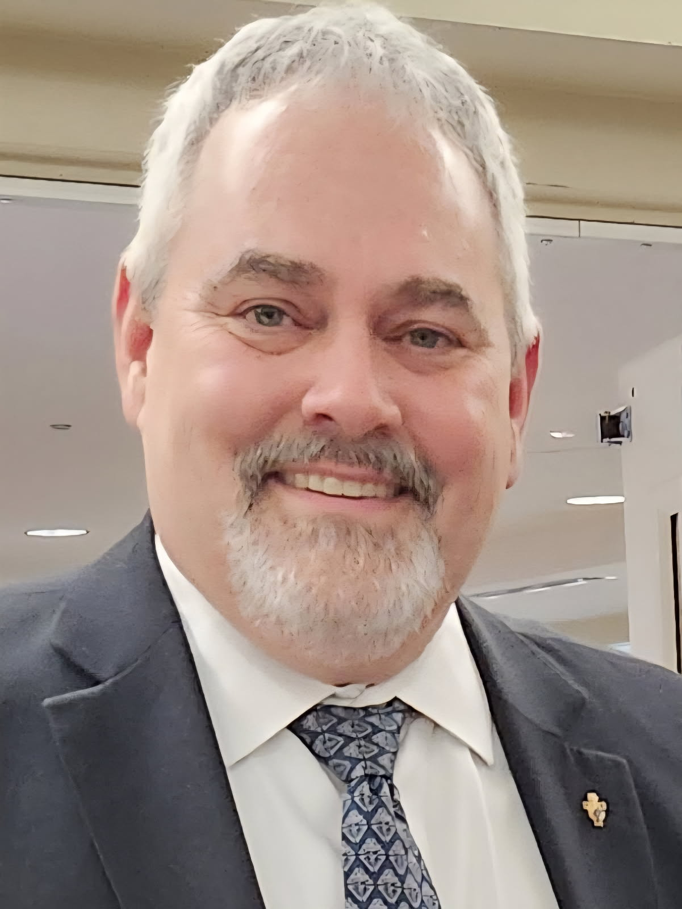
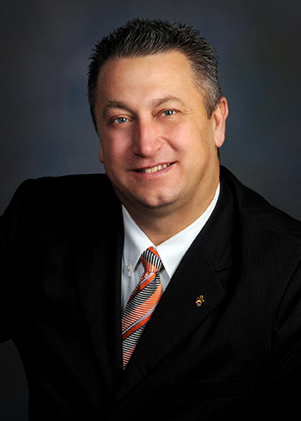
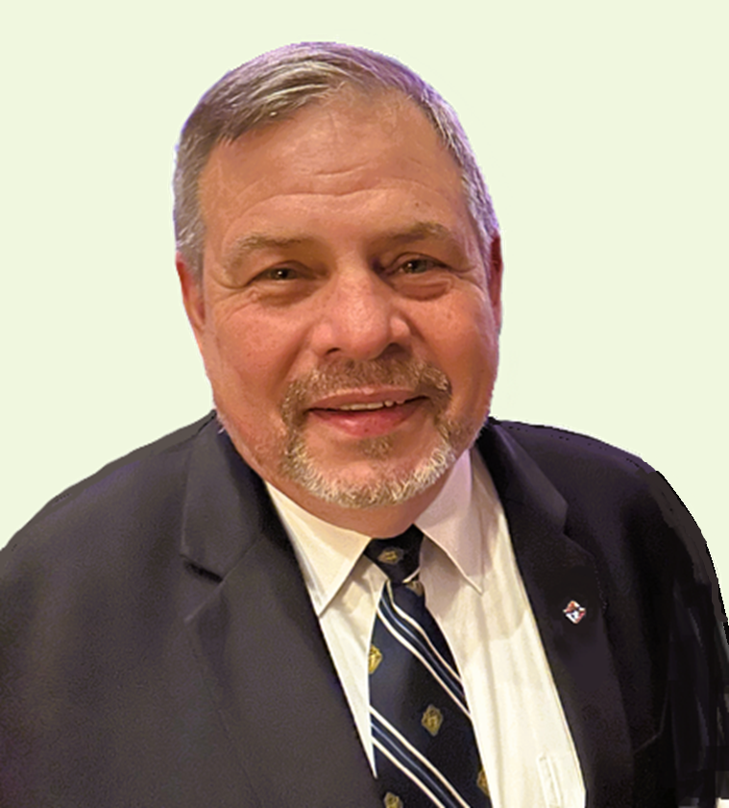
THE Central Territory
Regional Growth Specialist
Bill Chasse – PSD Michigan
Territorial Growth Director
Alain Cayer – PSD Ontario
Regional Growth Specialist
Ray Sands – PSD New Jersey
We are here for your needs of: Recruiting training, Church and Activity Drives, Townhall meetings, Reports, Mediate, History, and more…..
We are here to Help you succeed
Notes:
Our region is in the Central Territory
It is comprised of Maine, Illinois, Indiana and NH
Alain Cayer is the director and Bill Chasse and I are the Specialists
Yes - we have had a title change
– but the job is the same
- to help you succeed

Slide 3
EARLY IS EASY
944 District Deputy Report by September 1st/15th
185 Officers Chosen Report by July 1st
365 Program Personnel Report by July 1st
Safe Environment Complaint by August 1st
1295 Annual Audit by August 1st
1728 Fraternal Survey by January 1st
^{Founders Award by January 1st}
SP7 Columbian Award by April 1st
Notes:
One thing I will keep mentioning is EARLY IS EASY
NEED for SE and
Don’t wait for a due date – submit forms and reports as early as possible
Early is Easy – this can be carried into membership recruitment - now is not a last minute rush but rather an invitation to a fellow Catholics family to join our family

Slide 4
DISTRICT MONTHLY REPORT
New for this year for the Central Territory …
Monthly District Report on Membership Activity
Report is due the LAST TUESDAY for the month
^{For each council}
          Church drive date/location – expectations
          Event drive date/location – expectation
          ^{CUF scheduled date/ location}
Notes:
One thing I will keep mentioning is EARLY IS EASY
Don’t wait for a due date – submit forms and reports as early as possible
Early is Easy – this can be carried into membership recruitment - now is not a last minute rush but rather an invitation to a fellow Catholics family to join our family

Slide 5
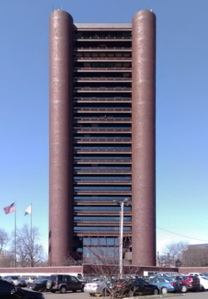
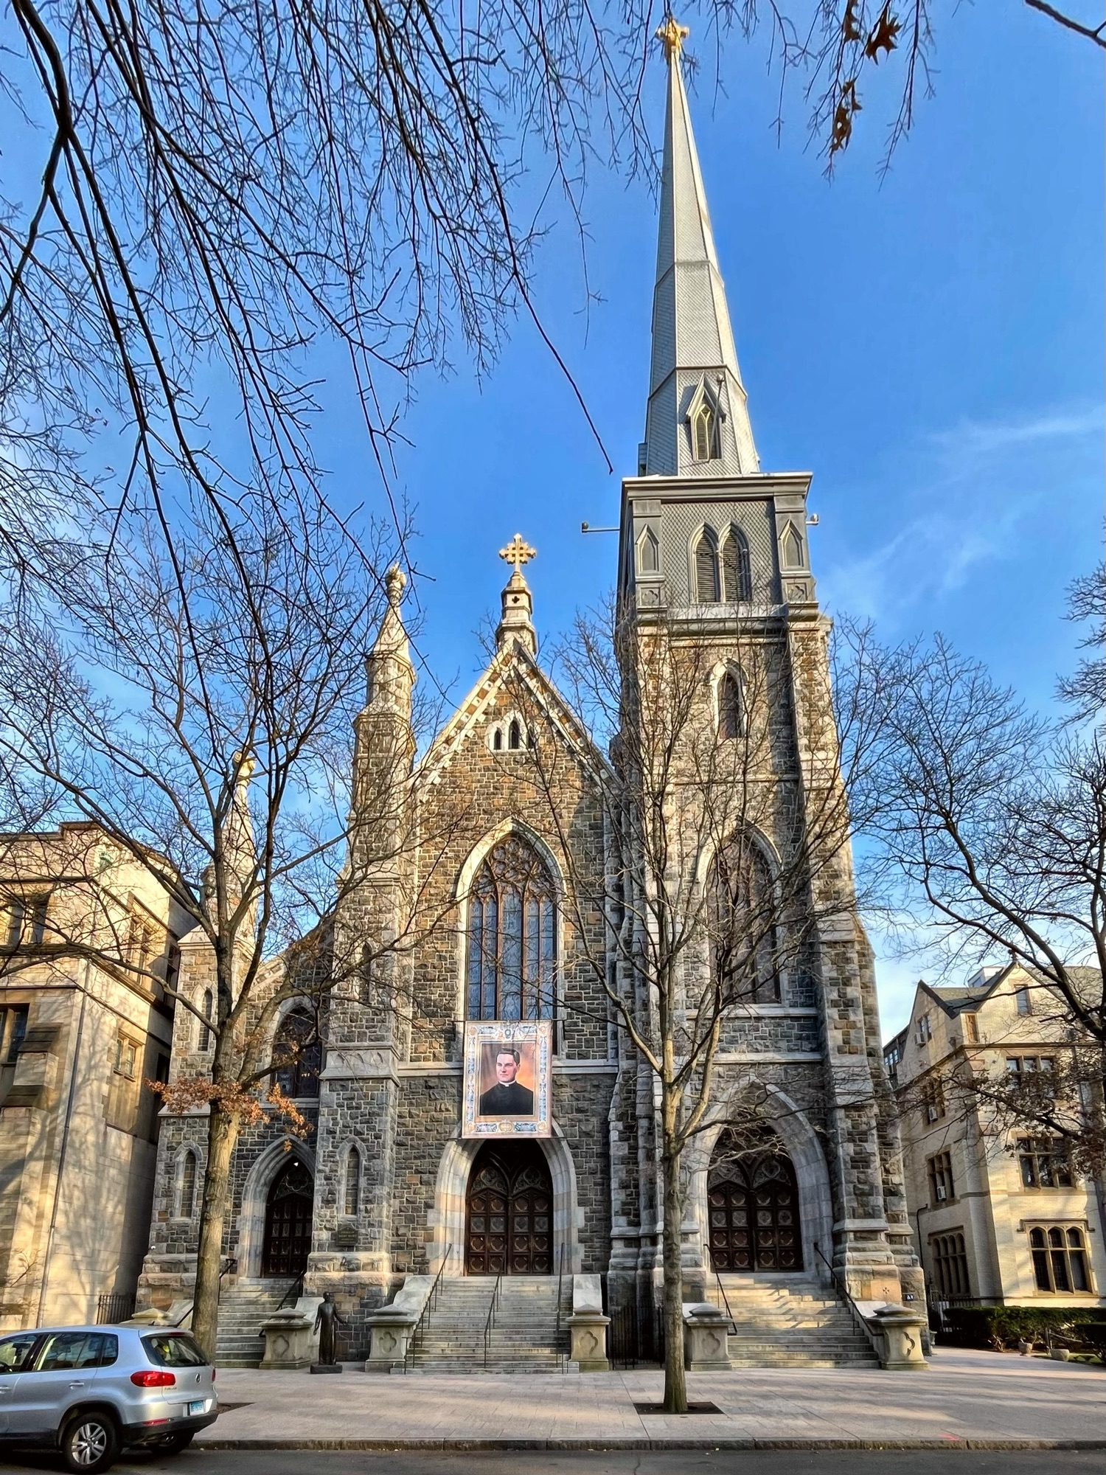
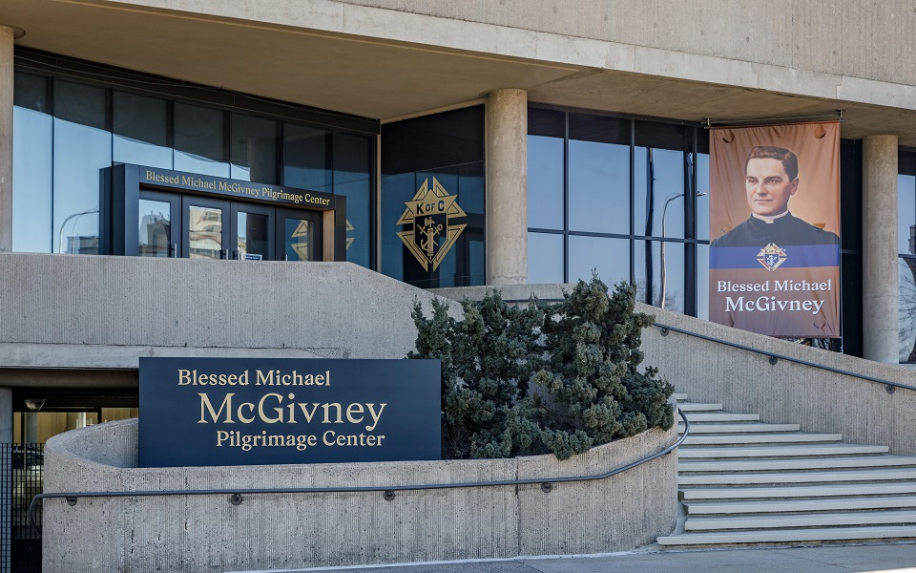
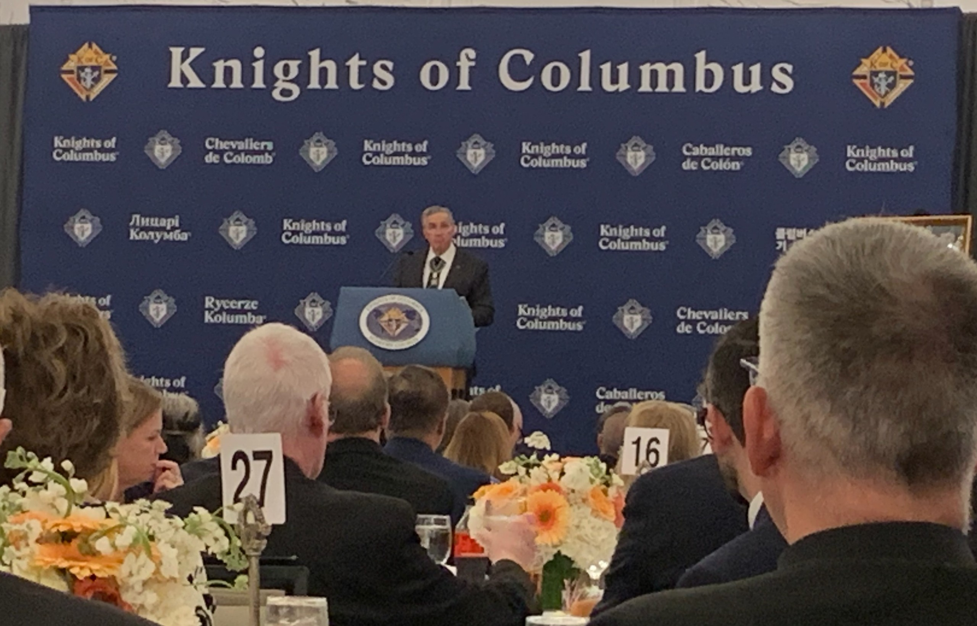
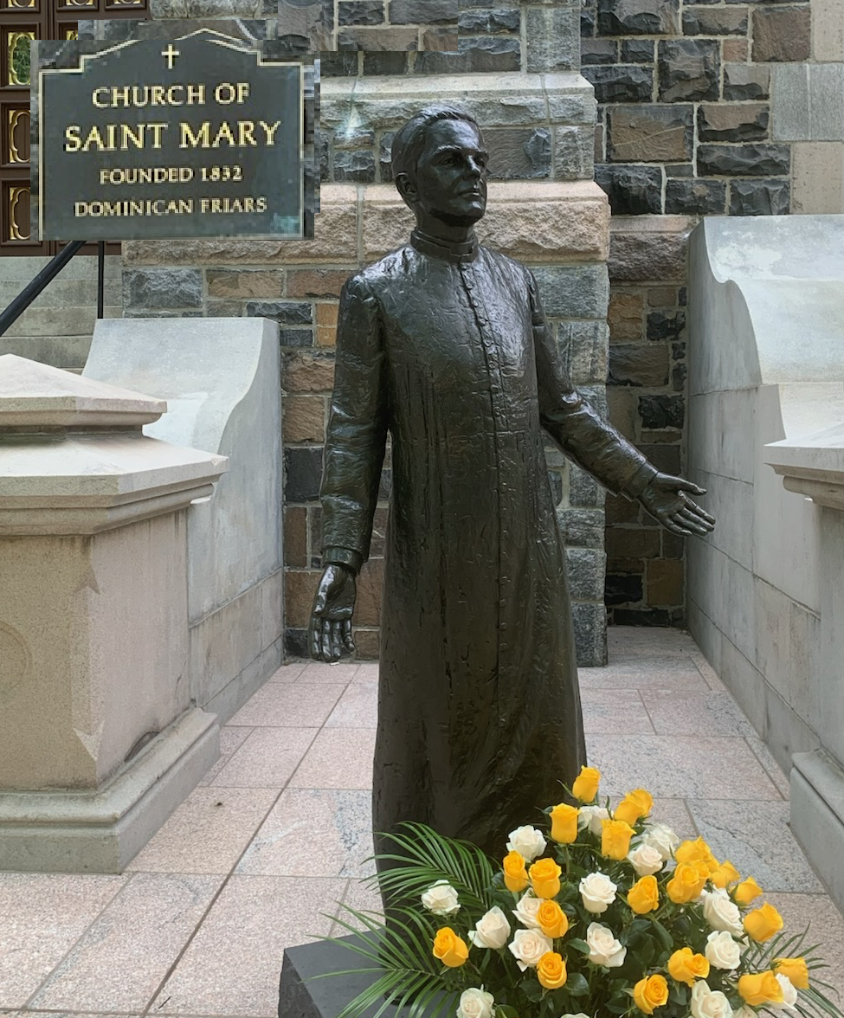
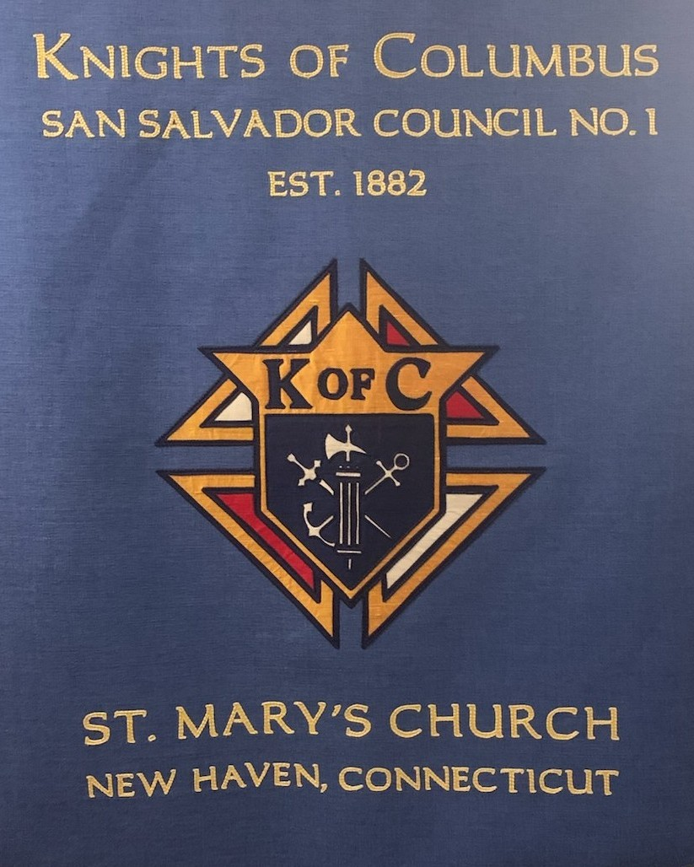
Notes:
The Supreme Council – we call it the home office - has been working hard to streamline the reporting process and make it easier for everyone to be involved

Slide 6
Report Updates

Slide 7
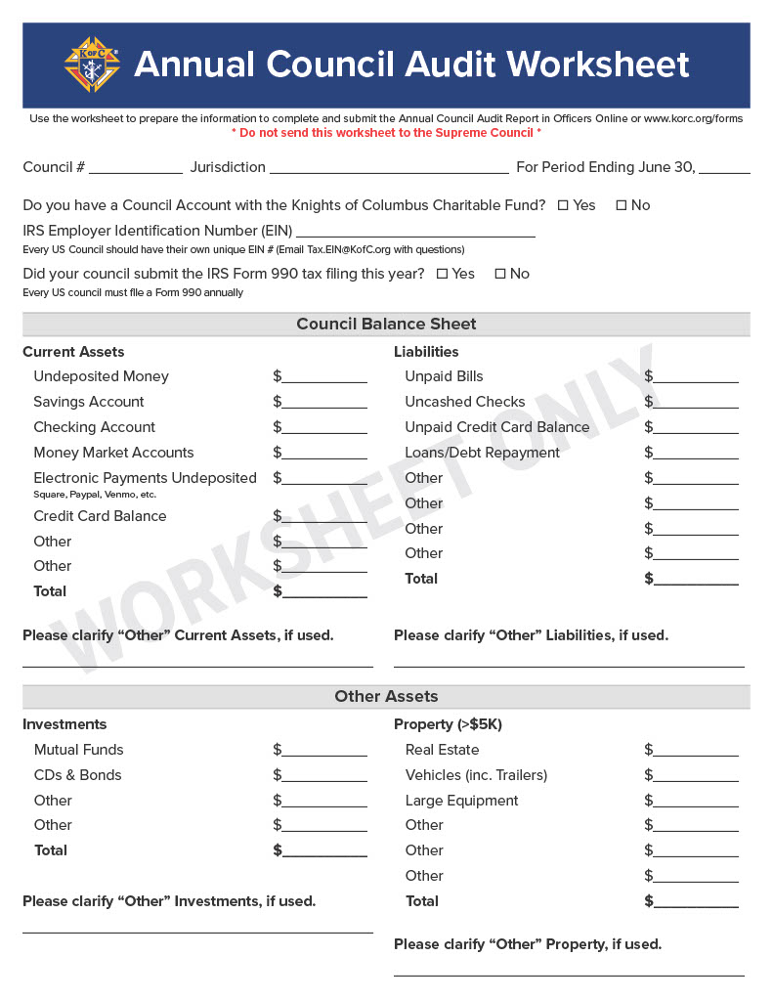
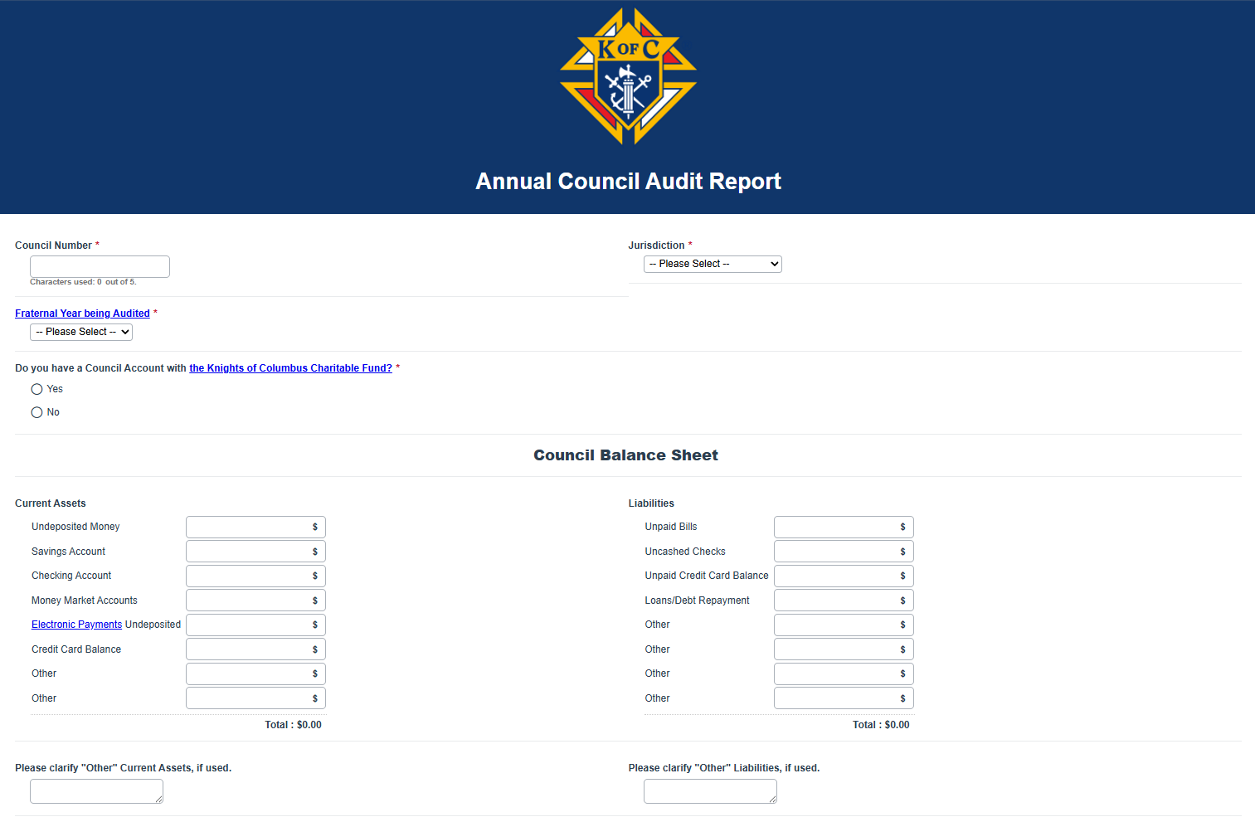
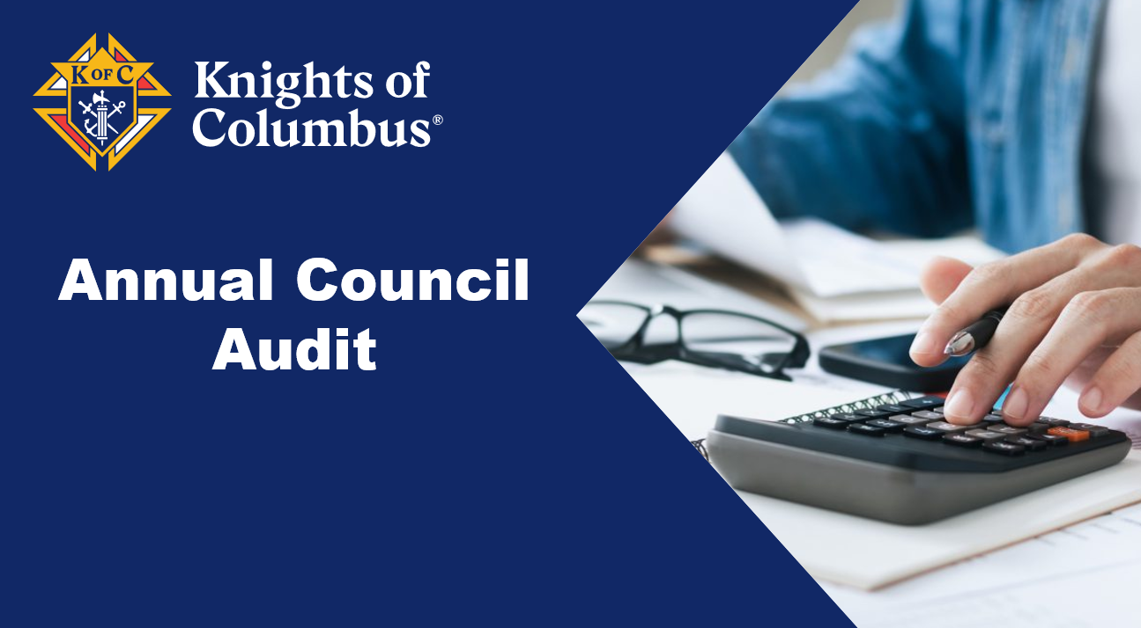
Annual Audit Resources
“Annual” (once a year)
Online Only
Due Aug. 15th
www.kofc.org/forms

Slide 8
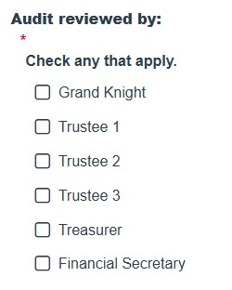
Annual Audit Resources
The audit needs to be reviewed by some combination of the GK, FS, Treasurer, and Trustees.
The council will check the boxes noting who reviewed it.
www.kofc.org/forms

Slide 9
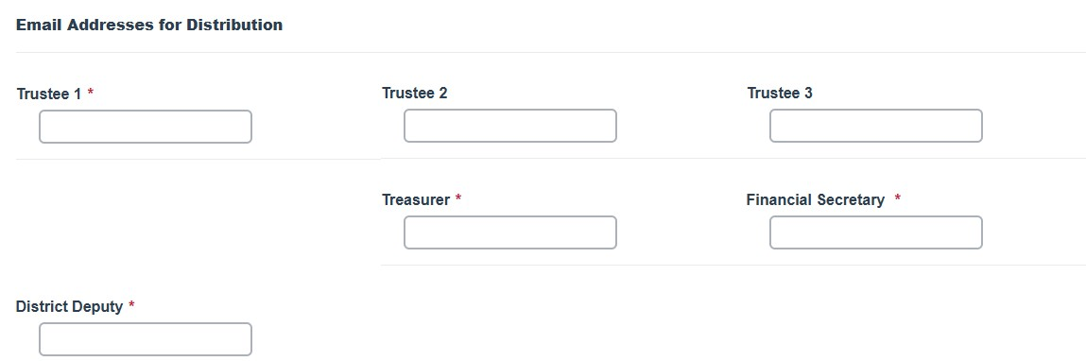
Annual Audit Resources
3. The council will then provide email addresses for those a copy is to be distributed to.
www.kofc.org/forms

Slide 10
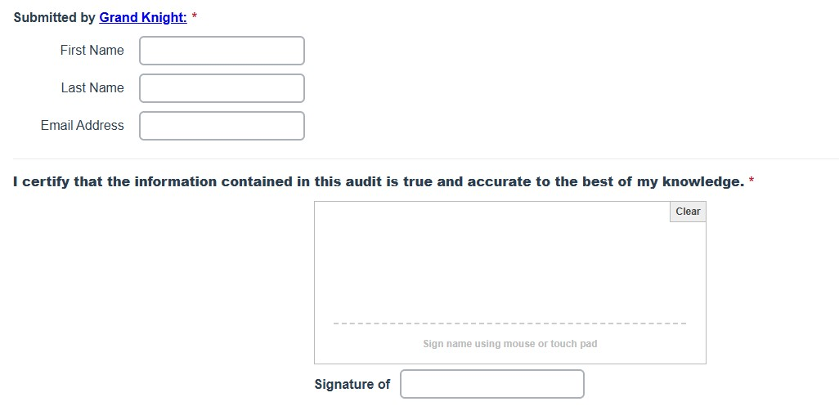
Annual Audit Resources
4. Finally, the Grand Knight will provide his information and electronically sign the document prior to submission.
www.kofc.org/forms

Slide 11
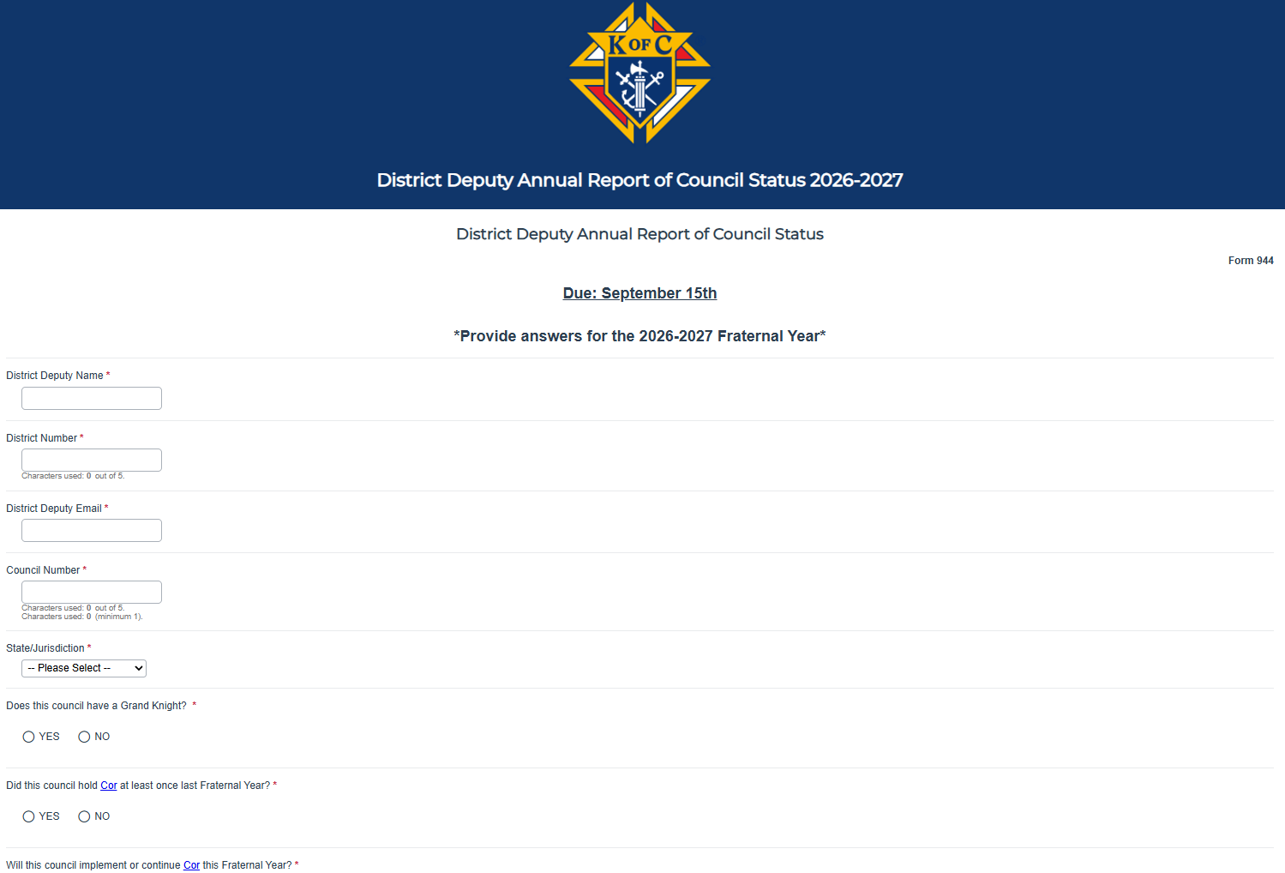
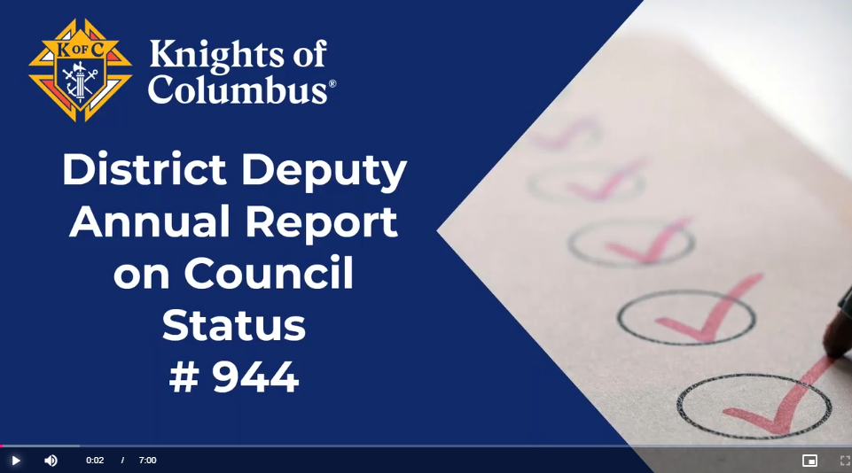
District Deputy Annual Report (#944)
“Annual” (once a year)
Online Only
ALL councils…active or not
Due Sept. 15th
www.kofc.org/forms
Notes:
944 has been

Slide 12
EARLY IS EASY
944 District Deputy Report by September 15th
185 Officers Chosen Report by July 1st
365 Program Personnel Report by July 1st
Safe Environment Complaint by August 1st
1295 Annual Audit by August 1st
1728 Fraternal Survey by January 1st
^{Founders Award by January 1st}
SP7 Columbian Award by April 1st

Slide 13
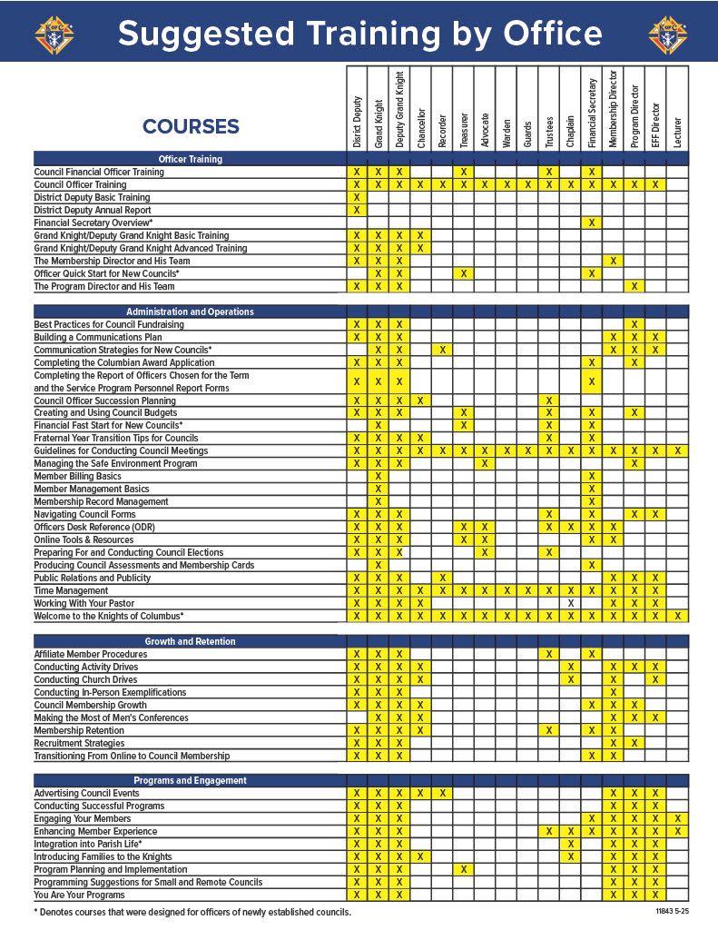
Suggested Training by Office Infographic
www.kofc.org/training
Form 11843

Slide 14
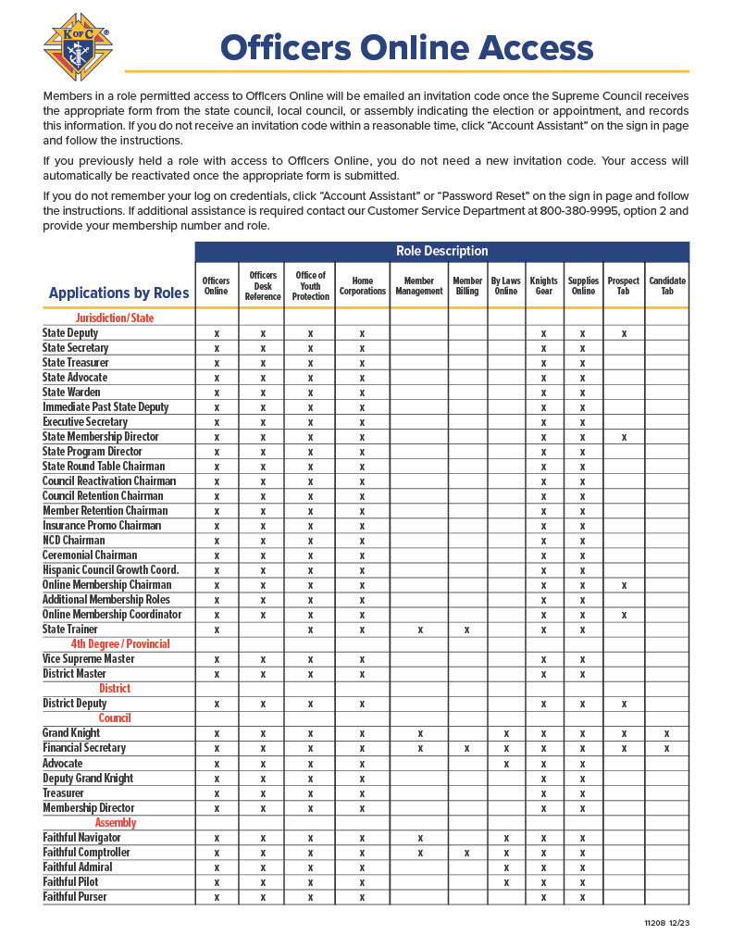
Officers Online Access Infographic
www.kofc.org/resources
Form 11208

Slide 15
Fraternal Resources

Slide 16
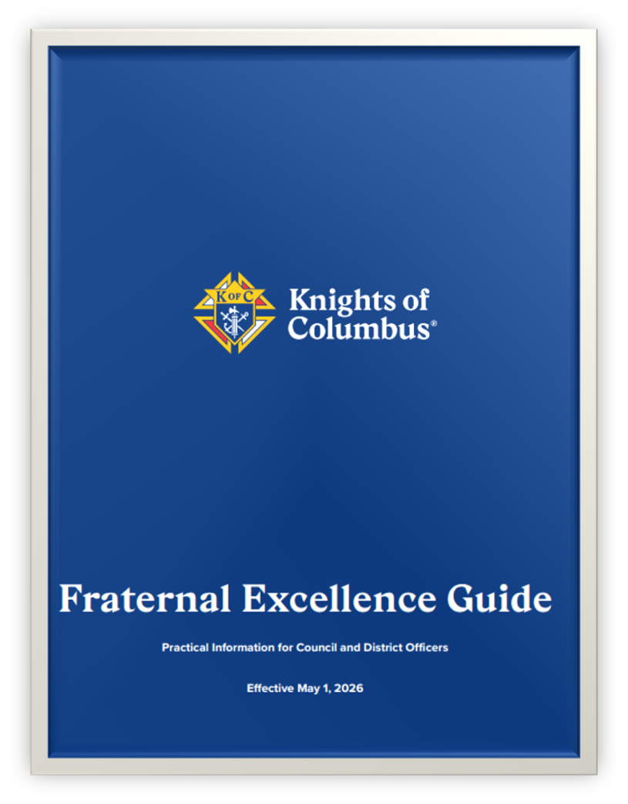
Updated Instructions
  Council Officer Duties
  Council Activies
  District Deputy Duties
  Membership
    Intake and retention
Notes:
Skim the guide

Slide 17
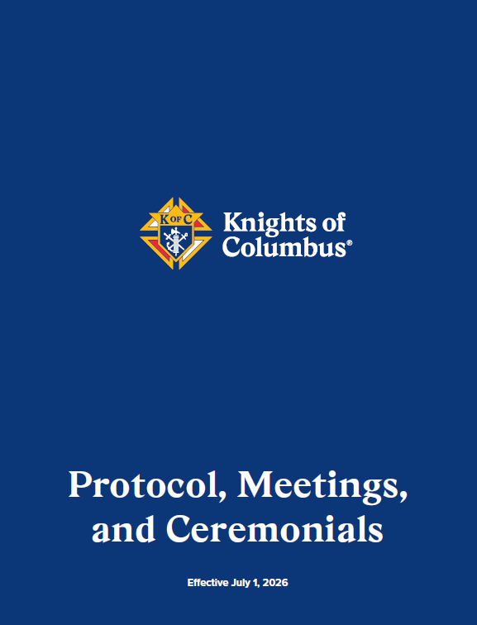

Updated Instructions
  Invite local Fourth Degree leaders
  Honor Guard
  Invite Field Agent
    Added as speakers in the Closing Remarks

Slide 18
Use this Fraternal Planner to:
  Find Key contacts, reporting, and helpful Links
  Set clear goals for membership growth and engagement through programs and fraternal activities
  Critical updates regarding Star Council
  Faith in Action guidelines and event scheduling

Slide 19
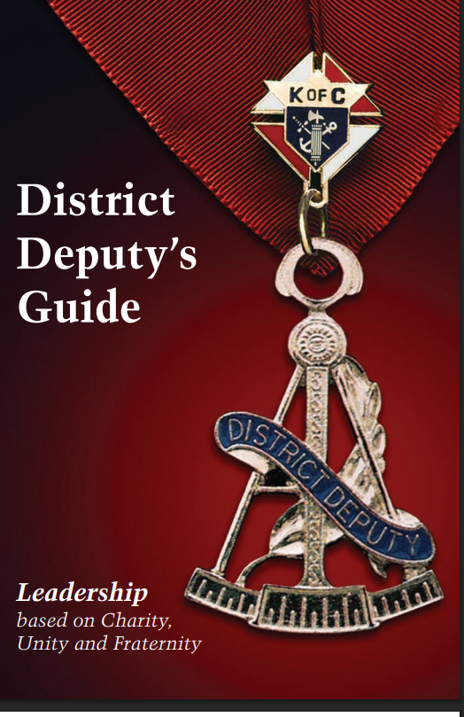
Use this District Deputy Guide to:
  A successful leader - understand your duties and responsibilities
  Mmake charitable works the council focus
  Ensure the councils are the “go-to guys” for parish pastors
  Encourage team building
  Make it a priority for councils to invite all eligible Catholic men to join

Slide 20
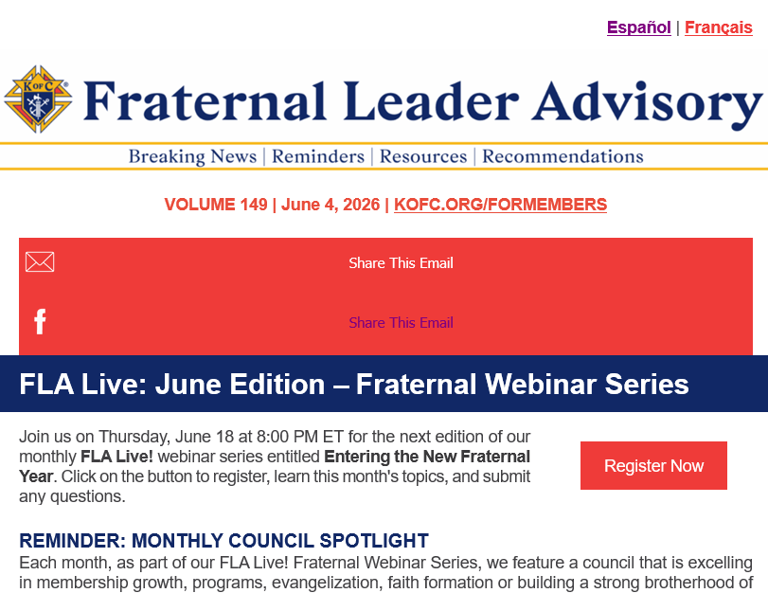
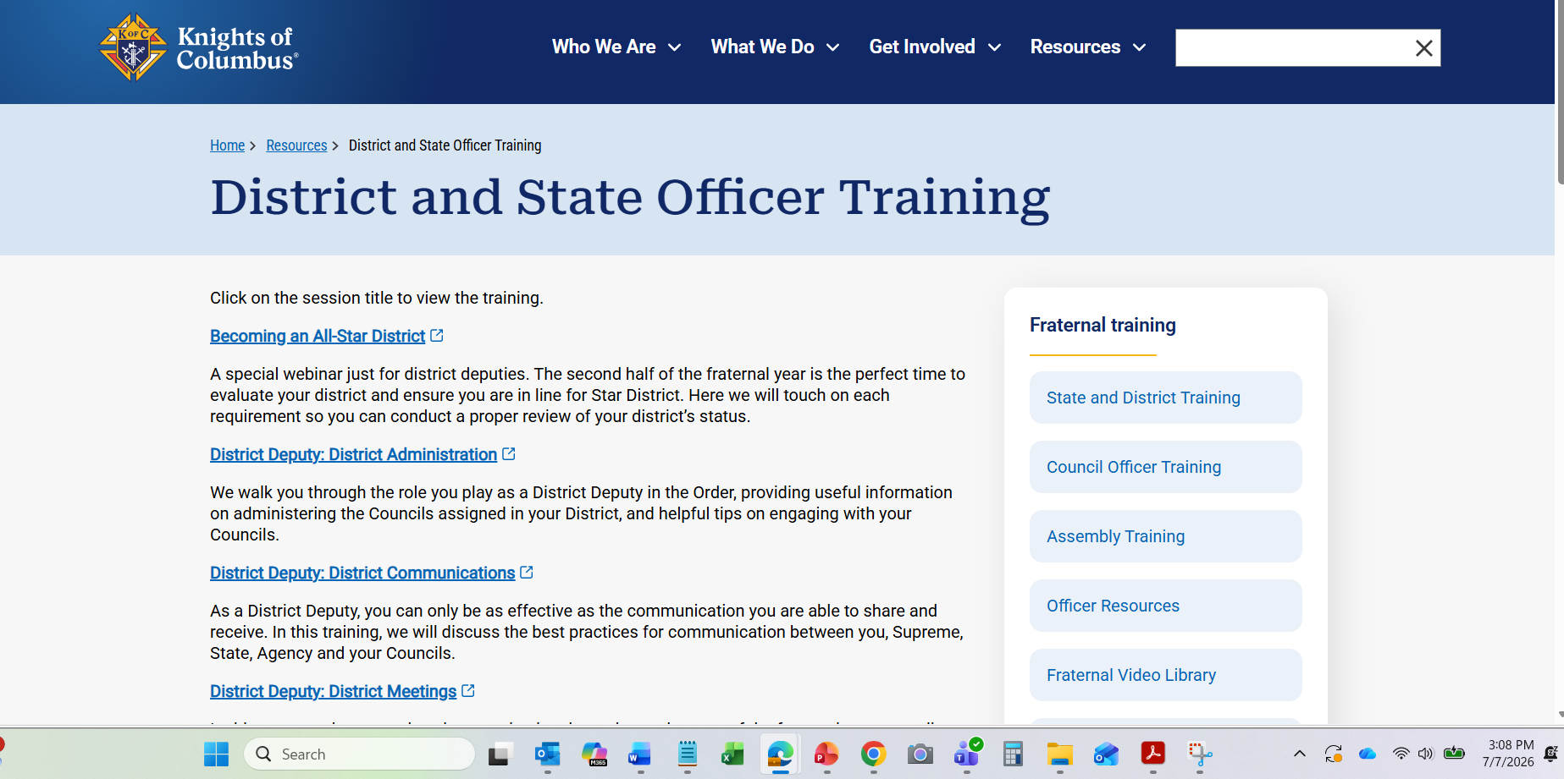
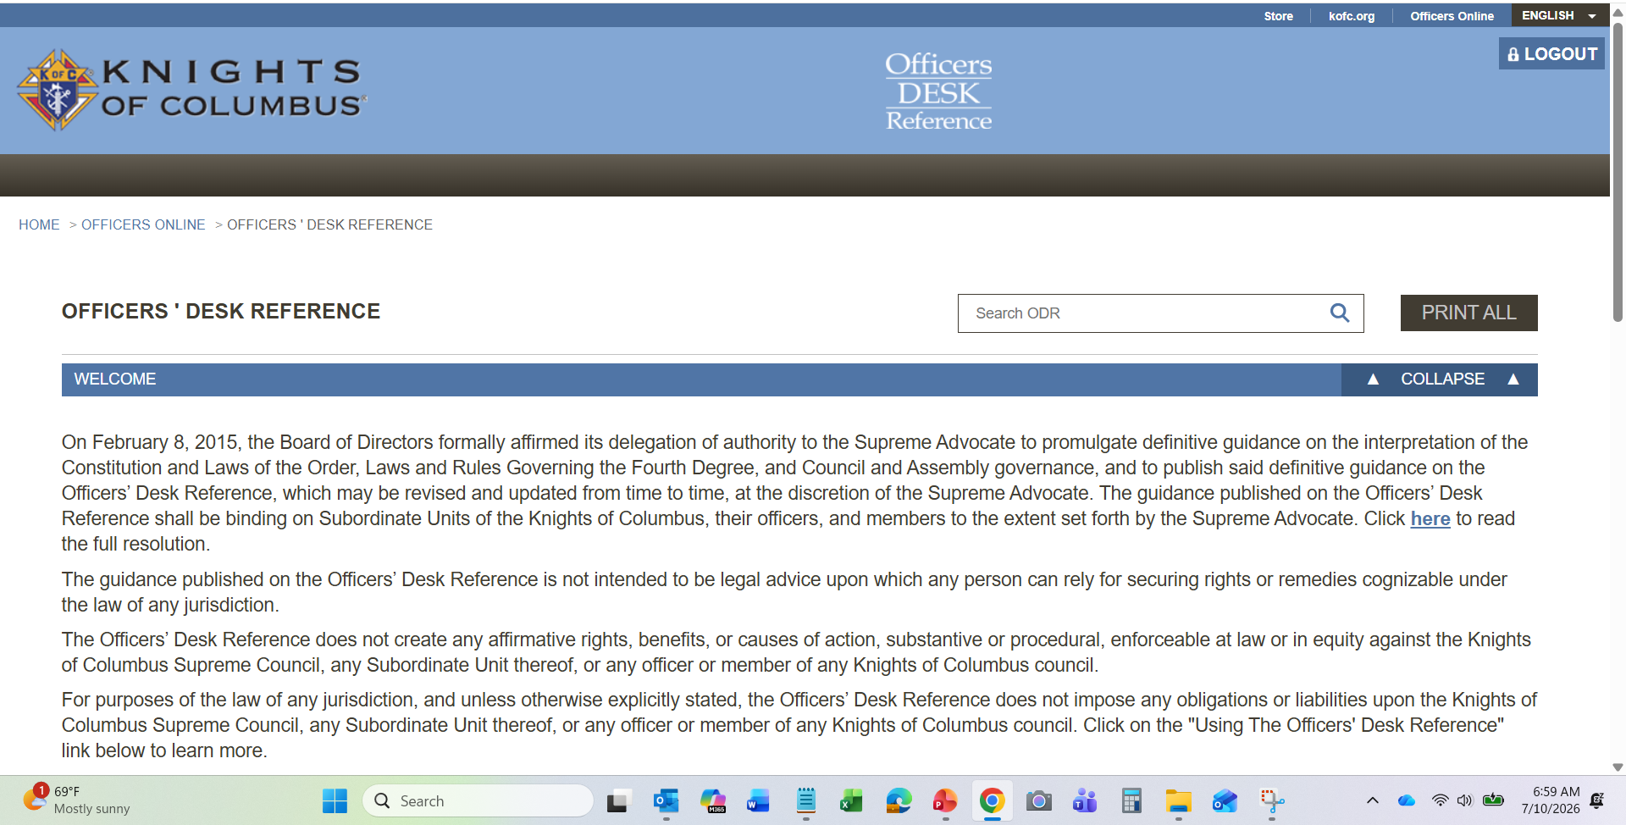
Notes:
Other resources that help you develop who you are as a leader are available ,, remind your GKs to take advantage themselves

Slide 21
Award Updates

Slide 22
Star District 2026 – 2027
Membership Growth (No Change)
  Attain 70% of combined council quotas
Insurance Promotion (No Change)
  At least 50% of assigned councils earn the Founders Award

Slide 23
Star District 2026 – 2027
Overall District Excellence
  At least two councils in the district earn the Star Council Award
    Districts with one council are not eligible
  Submit a District Deputy Annual Report on Council Status (#944) for each council in district by September 15
  Every council in district must submit forms #185 (officers), #365 (directors), 1728 (annual survey) and #1295 (annual audit)

Slide 24
Star Council 2026 – 2027
Earn the McGivney, Founders’, and Columbian Awards, and satisfy all administrative requirements
2026-2027 Administrative Requirements
Be in good standing with Supreme Council (pay assessments)
Safe Environment compliant (U.S. & Canada only)
Submit forms #185 (Report of Officers), #365 (Report of Directors), #1728 (Annual Survey)
NEW: Submit form #1295 (Annual Audit)

Slide 25
McGivney Award 2026 – 2027
NO CHANGES
Attain 6% intake growth based on July 1st council membership
Minimum 5 / Maximum 15

Slide 26
EARLY IS EASY
944 District Deputy Report by September 15th
185 Officers Chosen Report by July 1st
365 Program Personnel Report by July 1st
Safe Environment Complaint by August 1st
1295 Annual Audit by August 1st
1728 Fraternal Survey by January 1st
^{Founders Award by January 1st}
SP7 Columbian Award by April 1st

Slide 27
Founders’ Award 2026 – 2027
A number equal to 10% of Associate members on the July 1 council roster must meet individually with a field agent for a financial review
Minimum 5 / Maximum 15
To qualify, meetings must be with new or associate members
Notes:
Do not have to purchase unlike the old process w/ a sales goal

Slide 28
Founders’ Award 2026 – 2027
What is a Financial Review?
A financial review with an insurance agent is a personalized check-in to evaluate your current financial protection, identify gaps or changes in your needs, and ensure your insurance and long-term financial strategies still align with your goals, family, and future plans.
“Meet individually”, “personalized”…no group reviews.
Can be in person or virtual.

Slide 29
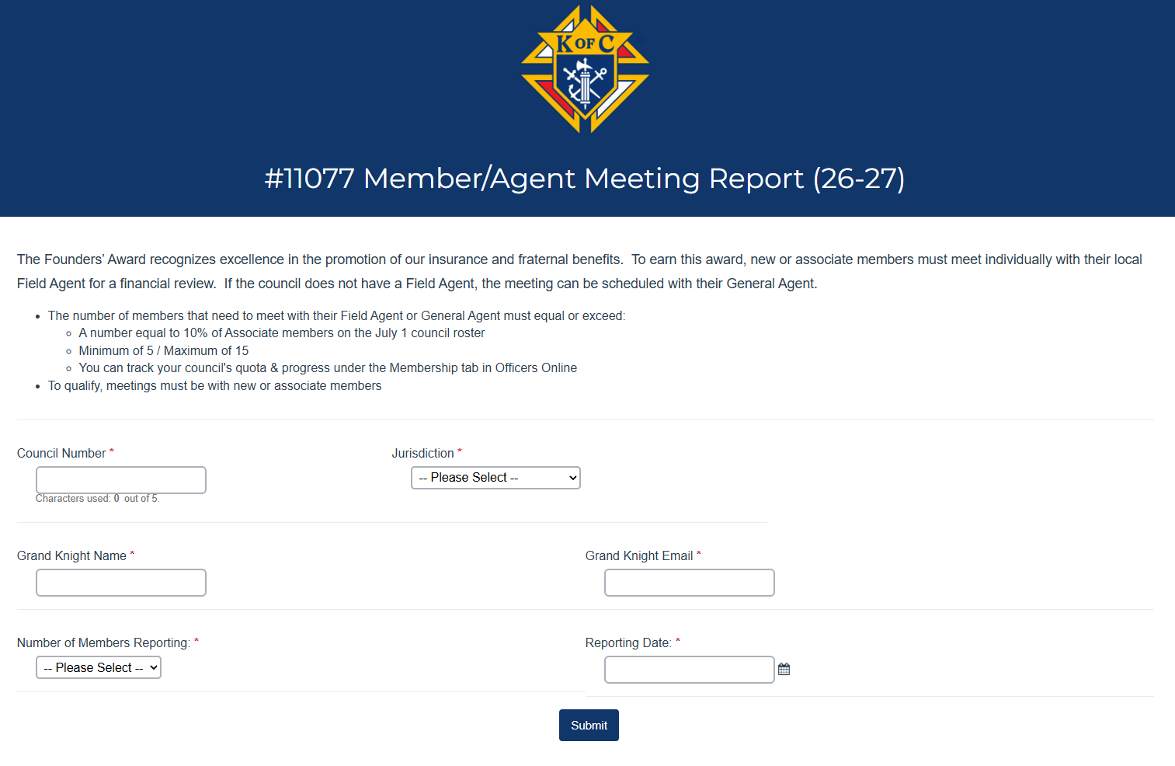
Can only be done online
Can list more than one member
Do not send to the Agency, General Agent or Field Agent. They are auto copied

Slide 30
Old Columbian Award
Time-consuming
Confusing to many
Subjective events
Quantity, not quality
Creative and lengthy writing

Slide 31
New Columbian Award
Fast
Simple
Online only
Quality, not quantity
3 Requirements
Still due by June 30, but can submitted as early as Jan. 1

Slide 32
Requirement 1
New Columbian Award
Donate $500 toward any of the following:
    ASAP (Aid and Support After Pregnancy)-(cash or item value)
    Food for Families (cash or 1,000 lbs.)
    Coats for Kids
    RSVP (Refund Support Vocations Program)

Slide 33
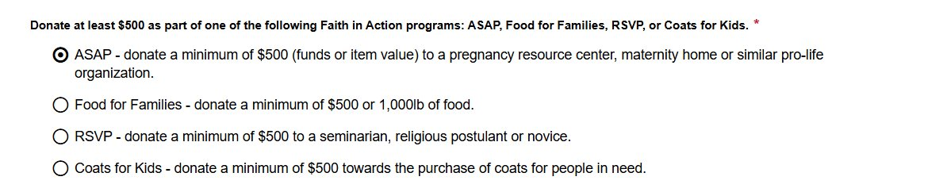
New Columbian Award
Requirement 1

Slide 34
Requirement 2
New Columbian Award
Complete 4 programs
    1 per category (Faith, Family, Community, Life)

Slide 35
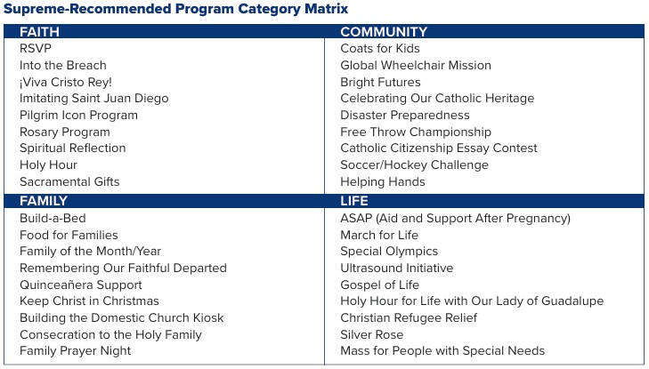
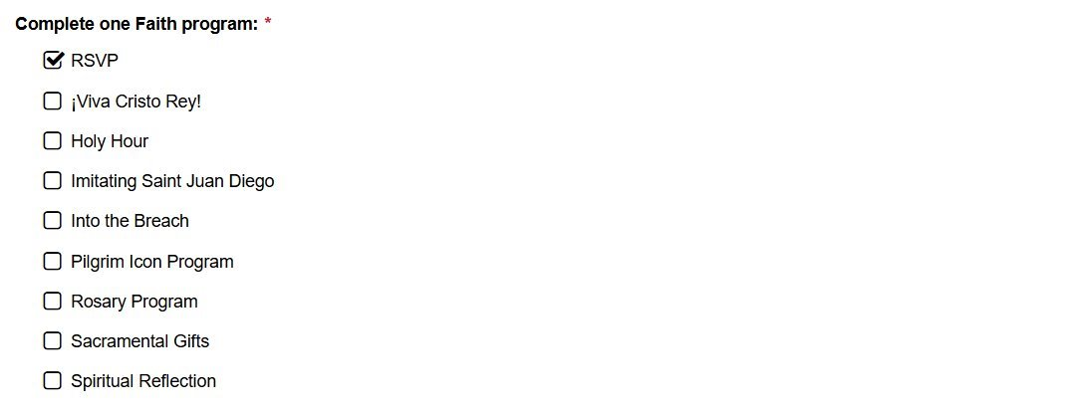
New Columbian Award
Requirement 2
Cannot claim program/activity already submitted for Requirment-1
Cannot claim program/activity already submitted for Requirment-1

Slide 36
Requirement 3
New Columbian Award
Conduct Cor monthly
    Include name and email of EFF Director
OR
  3 unique programs/activities (do not need to be FIA program)
    Build fraternity
    Bring men closer to Christ
    Serve parish or community

Slide 37
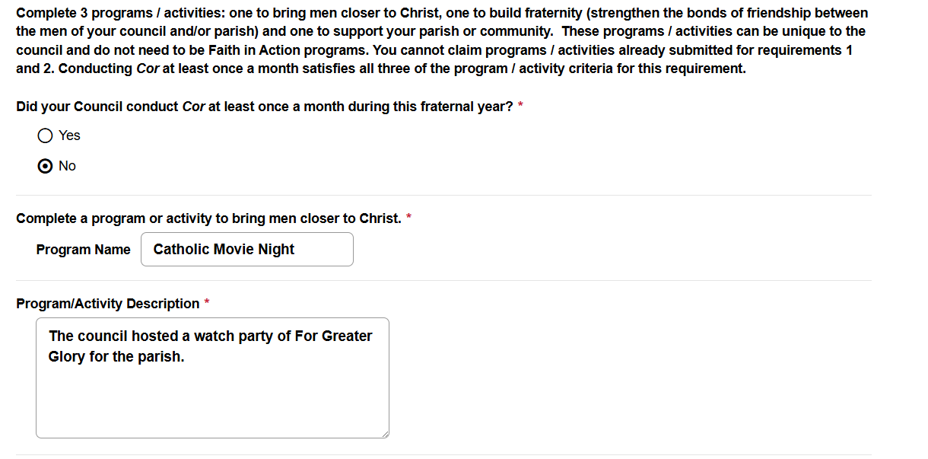
New Columbian Award
Requirement 3
Cannot claim program/activity already submitted for Requirment-1 and 2

Slide 38
Columbian Award Outcomes
Improved processing
    Fewer applications denied
    Faster approvals
Mission alignment
    More council donations
    More Cor participants
    More fraternal events
Happier councils, more members

Slide 39
2026-2027 Fraternal Mailing
Every Council FS will be mailed the following (1 copy of each)
Fraternal Planner
Fraternal Excellence Guide
Protocol, Meetings, and Ceremonials Book
Faith in Action Guidebook
Officers Online Access Infographic
Suggested Training By Office Infographic
Fishers of Men Guidebook
Cor Leader Guide
Cor Formation Content Guide
Working with Men’s Ministries
Every DD will be sent a link in their onboarding emails to download books
or have the option to order a set of hardcopy books.

Slide 40
EARLY IS EASY
944 District Deputy Report by September 1st/15th
185 Officers Chosen Report by July 1st
365 Program Personnel Report by July 1st
Safe Environment Complaint by August 1st
1295 Annual Audit by August 1st
1728 Fraternal Survey by January 1st
^{Founders Award by January 1st}

Slide 41
DISTRICT MEETINGS

Slide 42
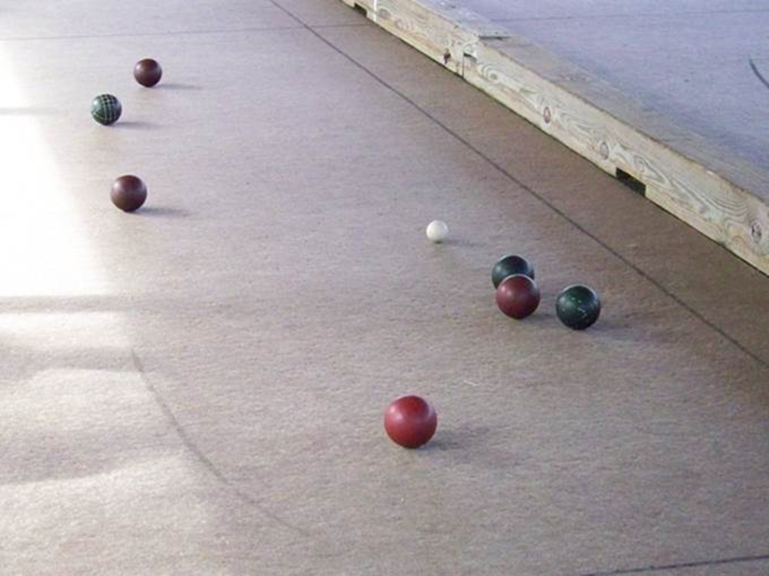
DISTRICT MEETINGS
Assist councils in your district in setting & planning realistic goal
    Goal without a Plan is just a dream
Invite your GA or FA to speak
    Promote our Order’s insurance program
Invite a priest/chaplain
    Develop working relationships with Diocese
Explain why Star Council Award
    Not about the award
    Its about the future and Blessed Mcgivney’s Legacy
Notes:
The home office reviewed all of the programs that were out there with goals
to Focus- -streamline
make the process easier and less cumbersome by remove - eliminate - and add

